Slide 1
Essentials of Generative AI
Notes:
Welcome to the world of Generative AI! Let's uncover the foundational elements that power creativity and innovation in artificial intelligence.

Slide 2
Optimizing GenAI Models
Notes:
Let's learn how to make our GenAI models more efficient and effective.

Slide 3
GenAI designs various types of creative content, including images, text, and music, emphasizing its role in creative endeavors.
LLMs like ChatGPT are advanced AI models that go beyond understanding human language. It also processes and analyzes data in various formats, such as images, graphs, and charts.
Notes:
Let's quickly review the key points we've covered so far.

Slide 4
You are working on a document and must quickly summarize a lengthy report. Instead of reading the entire report yourself, copy and paste it into a GenAI writing assistant. With a simple prompt like Summarize the following text in 3-4 concise paragraphs, the AI generates a clear and concise summary for you in seconds.
How does the AI system understand and extract the key points from a lengthy text to generate a concise and structured summary from the simple prompt you provided?
Notes:
Mode: Sync
Estimated duration: 10 mins
Type: Instructor-led whole group discussion
Instructor Note:
Facilitate a whole group discussion to kick off today’s lesson. Ensure that you do not spend much time discussing the answers. This slide aims to gain the learners’ attention and relate the lesson theme with relatable examples before starting with the actual lecture topic.
1. Open a document containing 1 to 2 pages of text.
2. Access the ChatGPT interface and input the command: 'Summarize the following text in 3 to 4 concise paragraphs.’ Then, paste the complete text from the document into the chat.
3. Showcase the response.
4. Afterward, ask the Question: 'How does the AI system understand and extract the key points from a lengthy text to generate a concise and structured summary, just from that simple prompt we provided?
5. Allow 2 to 3 minutes for learners to respond, and then explain the process as follows:
In this case, the instruction 'Summarize' directs the AI to produce a brief overview of the given text. 'The following text' indicates that the AI should focus on the content provided immediately after the command. Lastly, 'in 3 to 4 concise paragraphs' provides specific guidance on the structure of the summary, prompting the AI to organize the information into 3 or 4 brief paragraphs.
This deconstruction and precise communication of the task through the prompt is the essence of prompt engineering. With well-designed prompts providing clear context and instructions, AI models can better understand and execute the desired actions accurately.
Throughout our discussion today, we will explore prompt engineering further; let’s look into the learning objectives of this lesson.

Slide 5
Generate effective prompts for optimizing interactions with GenAI models
Apply advanced prompting techniques, such as zero-shot, few-shot, chain-of-thought, self-consistency, and tree-of-thought, to generate the desired output from the GenAI model
Understand the concepts of pre-training and fine-tuning the GenAI models to enhance domain-specific performance
Notes:
Mode: Sync
Estimated duration: 2 minutes
Type: Instructor-led
Instructor Note:
State the learning objectives of the lesson.

Slide 6
Introduction to Prompt Engineering
Notes:
Let's begin by understanding the basics of prompt engineering.

Slide 7





Prompt Engineering
Prompt engineering involves instructing conversational AI models, such as ChatGPT, to generate desired outputs.
A well-built prompt must have:
Clarity
Specificity
Format
Context
Notes:
Trainer Note:
Prompt engineering is the art of writing instructions to a chatbot such as ChatGPT and driving specific instruction to get the desired output.​
​
Importance:​
It helps in determining the right output​
It influences response styles​
Helps you to achieve your desired objective or goal with Gen AI​
A few factors that should be considered while building a prompt are:
Clarity: Prompts should be clear and your goal has to be outlined precisely​
​
Specificity: The more specific the prompt the better output you will get​
​
Format: The structure and format of prompts can impact the quality of writing​
​
Context: Giving all details to the AI chatbot helps you in getting desired output​

Slide 8
Importance of Prompt Engineering
It is increasingly recognized as a crucial skill set in the realm of GenAI. Here are several key reasons why prompt engineering is needed:
Maximize AI potential
Encourage AI literacy and creativity
Enhance user-AI interaction
Support ethical AI use
Increase efficiency
Notes:
Trainer Note:
In essence, prompt engineering is essential for harnessing the full capabilities of advanced AI models, enabling more precise, efficient, and innovative interactions between humans and machines. It represents a critical step towards fully realizing the potential of AI technology in various aspects of work, creativity, and problem-solving.
Maximizing AI Potential: Prompt engineering helps users tailor prompts to elicit the most accurate, relevant, and coherent responses from AI, maximizing the model's utility and effectiveness for various tasks.
Enhancing User-AI Interaction: It facilitates clearer and more effective communication between humans and AI, ensuring that the AI better understands the user's intent and provides responses that meet their specific needs.
Increasing Efficiency: Effective prompt engineering reduces the time and effort spent on trial and error by providing strategies and insights on how to communicate more effectively with AI, leading to quicker, more desirable outcomes.
Supporting ethical AI use: By understanding and controlling the prompts given to AI, prompt engineering can play a role in guiding AI towards more ethical and responsible outputs, avoiding harmful biases or inappropriate content.
Encouraging AI Literacy and Creativity: It encourages users to think creatively about how they interact with AI, fostering innovation in AI applications and promoting a deeper understanding of AI capabilities and limitations.

Slide 9
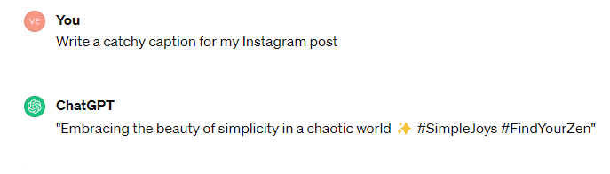
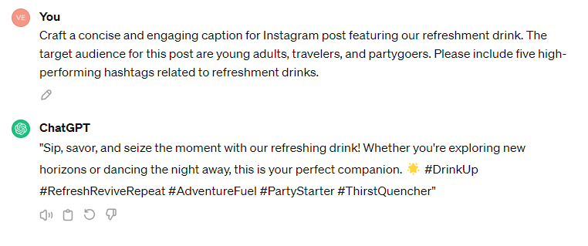
Prompts: Examples
Whenever you give a generic prompt, you'll get a random response each time, but engineered prompts will bring back a relevant response.
Generic prompt
Engineered prompt
Note
The generic prompt lacks detail. The engineered prompt offers clarity which allows a focused, relevant response.
Notes:
Instructor Notes:
Duration: 5mins
Demonstrate the prompts using ChatGPT to the learners

Slide 10
Advanced Prompting Techniques
Notes:
Let's explore advanced techniques for crafting effective prompts

Slide 11

Prompting Techniques: From Basics to Advanced
Listed below are some advanced techniques for prompting GenAI models to achieve desired outcomes.
Zero-shot prompting
Few-shot prompting
Chain-of-thought prompting
Self-consistency prompting
Tree-of-thought prompting
Notes:
This slide is self-explanatory

Slide 12

Zero-Shot Prompting
It is a technique that provides a quick response with minimal guidance, helps in setting the context, and gives the desired output without any specific examples.
Its existing knowledge is used for task execution.
Notes:
Definition​
Zero-shot prompting refers to a style of prompt where you don’t give the model any specific example, to work with, one can leverage the model's existing knowledge base and ask it to perform a specific task of your choice​
Advantage​
No training required - You need not train the model on your content, it uses its existing knowledge base and writes content​. Eg If you're diving into a subject you're not familiar with, you may consider using Zero shot prompting ​
Always tries to give the desired output - The model is trained to give you a desired output​
Quick response with minimal guidance - Zero shot prompting is perfect when you need a quick response on a wide range of topics without diving too deep and understand the concept​
Helps in context setting - When you don’t have any knowledge of a certain topic, one can gain enough knowledge or get context by reading output given by the chatbot​

Slide 13
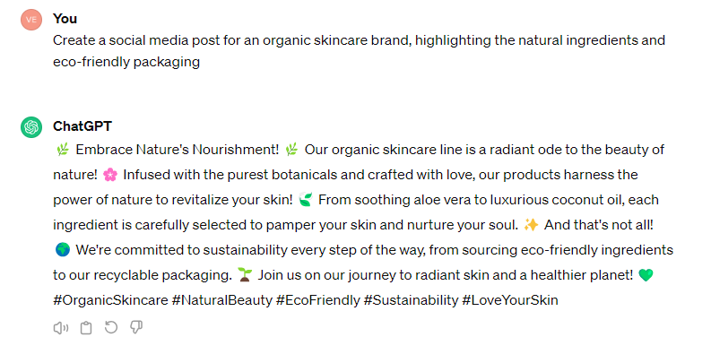

Do It on Your Own: Zero-Shot Prompting
Use ChatGPT to try out the prompt below:
Generating social media posts for a brand
Notes:
Duration: 5mins
Instructor notes:
Open ChatGPT
Copy paste the below prompt:
Create a social media post for an organic skincare brand, highlighting the natural ingredients and eco-friendly packaging.
3. Copy paste the same prompt in zoom chat and instruct the learner to try using ChatGPT
4. Explain: The example below demonstrates how zero-shot prompt can still get the output you want with minimal guidance.

Slide 14
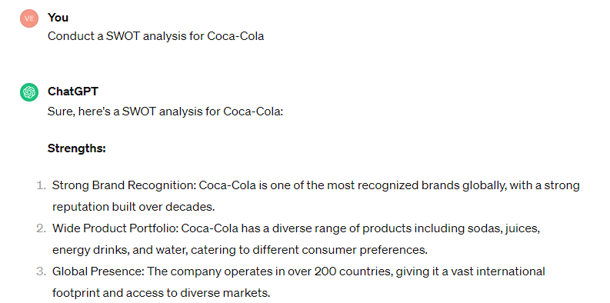

Do It on Your Own: Zero-Shot Prompting
Use ChatGPT to try out the prompt below:
Performing a SWOT analysis
Notes:
Duration: 5mins
Instructor notes:
Open ChatGPT
Copy paste the below prompt:
Conduct a SWOT analysis for Coca-Cola.
3. Copy paste the same prompt in zoom chat and instruct the learner to try using chatGPT
4. Explain: The example below demonstrates how zero-shot prompt can still get the output you want with minimal guidance.

Slide 15
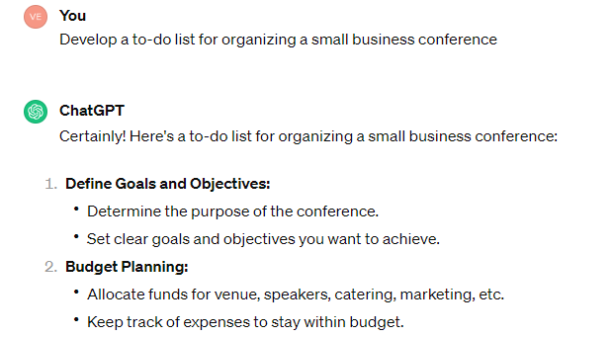

Do It on Your Own: Zero-Shot Prompting
Use ChatGPT to try out the prompt below:
Building a to-do list
Notes:
Duration: 5mins
Instructor notes:
Open ChatGPT
Copy paste the below prompt:
Develop a to-do list for organizing a small business conference
3. Copy paste the same prompt in zoom chat and instruct the learner to try using chatGPT
4. Explain: The example below demonstrates how zero-shot prompt can still get the output you want with minimal guidance.

Slide 16

Few-Shot Prompting
It is a style of guiding GenAI models with specific examples to achieve desired responses.
Provides the model with a limited number of specific examples and a definite context
Focuses on providing training sessions to the GenAI bot, enhancing the relevance and precision of the output
Offers a clearer idea of the specific task or style while leveraging the model’s existing knowledge
Notes:
Definition
Few-shot prompting is a style of prompting where you lead by example. In this model you start by providing the model with a few specific examples to guide its responses and set the context. It's similar to providing the AI bot a brief but focused training session. This gives relevant and precise output. You still leverage the model's existing knowledge, but you also give it a clearer idea of the specific task or style you're looking for

Slide 17
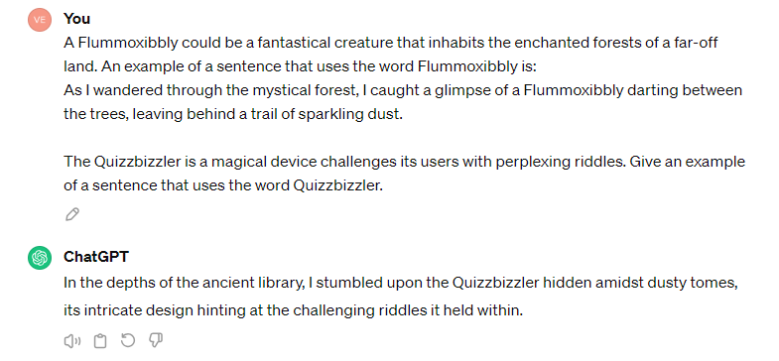
Do It on Your Own: Few-Shot Prompting
Use ChatGPT to try out the prompt below:
Notes:
Instructor notes:
Open ChatGPT
Copy the prompt from the slide and paste it into the chatGPT:
Copy and paste the prompt in Zoom chat and instruct learners to try using chatGPT.
Explain: The prompt we just used in this demonstration is an example of a Few-shot prompt. Few-shot prompting involves providing the model with a limited number of examples or instances related to the task at hand.

Slide 18
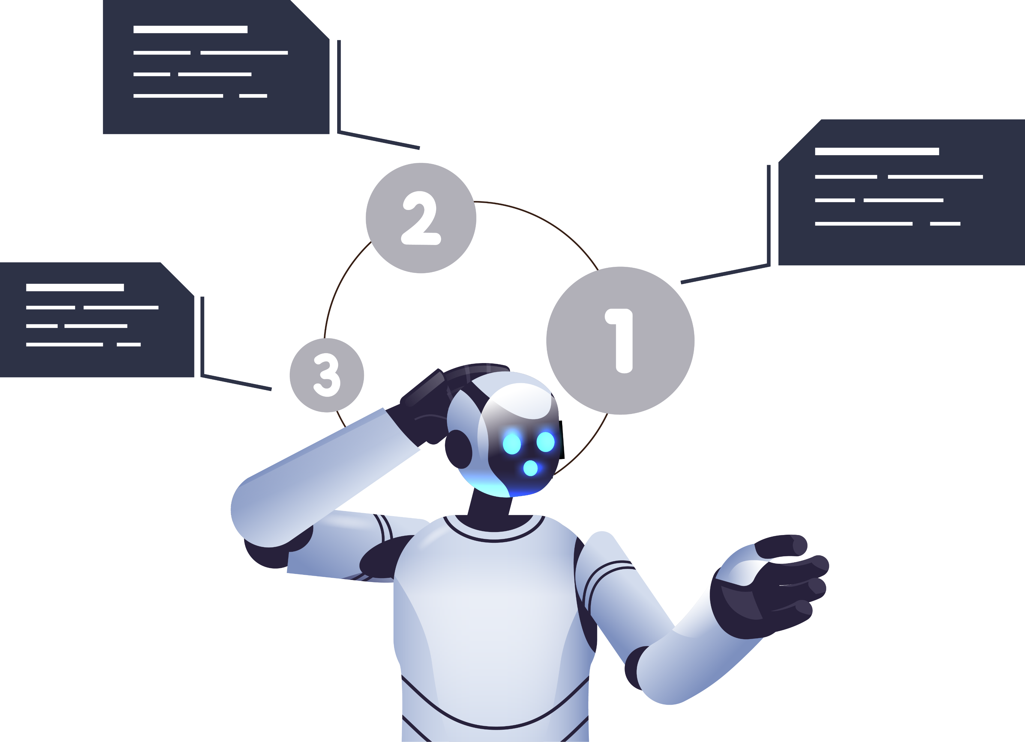
Chain-of-Thought Prompting (CoT)
It is a method of providing sequential prompts to the GenAI model to generate sequential outputs, rather than getting the entire output at once.
It encourages more thoughtful and detailed responses by avoiding the overload of multiple questions at once.
Notes:
Chain of Thought Prompting - This is a method where you ask the LLM model to provide the output in a sequential manner rather than giving a single prompt and getting the entire output all at once. The answer given here is more precise and detailed since you don't overload the model with too many questions to think about at once.

Slide 19
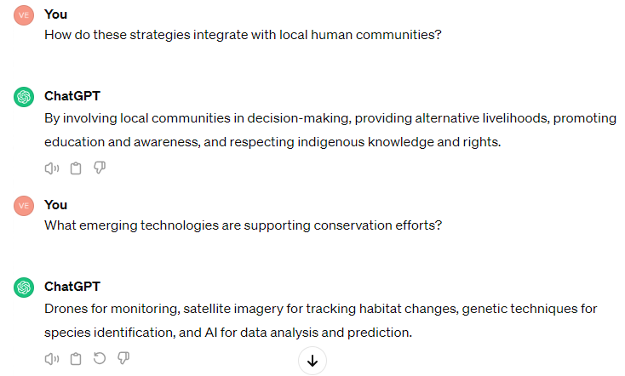
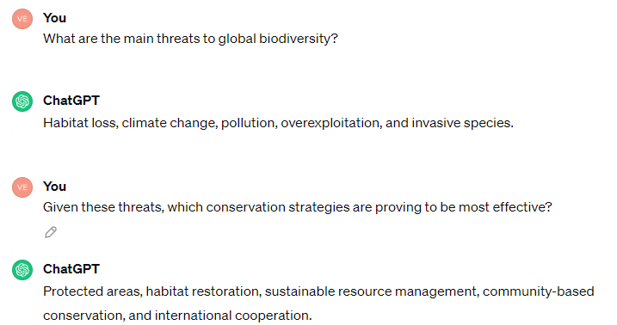
Do It on Your Own: Chain-of-Thought Prompting
Use ChatGPT to try out the prompt below:
Notes:
Instructor notes: Demonstrate using ChatGPT
Ask the learners to perform along
Consider discussing the topic of environmental conservation.
First prompt: What are the main threats to global biodiversity?
Answer: Climate change, habitat destruction, pollution, and overexploitation of species.
Next prompt: Given these threats, which conservation strategies are proving to be most effective? Answer: The establishment of protected areas, sustainable resource management practices, international agreements like the Convention on Biological Diversity, and strict enforcement of wildlife trafficking laws.
Follow-up prompt: How do these strategies integrate with local human communities? Answer: Conservation efforts are increasingly adopting a community-based approach, providing economic incentives for conservation, ensuring that local and indigenous peoples' rights are respected, and their knowledge is integrated into conservation planning.
Final prompt: What emerging technologies are supporting conservation efforts? Answer: Technologies such as satellite imagery for habitat monitoring, drones for anti-poaching operations, AI for data analysis in population management, and genetic techniques for biodiversity assessment are supporting conservation efforts.
Explain: This is chain of thought.

Slide 20

Self-Consistency Prompting
It ensures that a GenAI bot delivers reliable and similar responses when asked the same questions repeatedly.
Example
Repeatedly prompting "What's the capital of France?" should consistently yield the answer Paris.
This process makes the AI more reliable, reduces confusion, enhances the user experience, and paves the way for efficient learning.
Notes:
Self-Consistency Prompting is a method used to make sure an AI, like a chatbot, gives reliable and similar answers when asked the same question multiple times.
Imagine asking a friend the same question on different days and getting wildly different answers each time; it would be confusing, right?
This technique helps prevent that kind of confusion with AI.
Example -
If we prompt "What's the capital of France?" several times, the answer should be “Paris”
This process makes the AI more reliable, reduces confusion, enhances user experience, and paves the way for efficient learning.

Slide 21
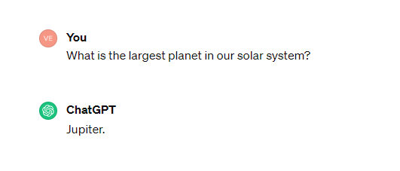
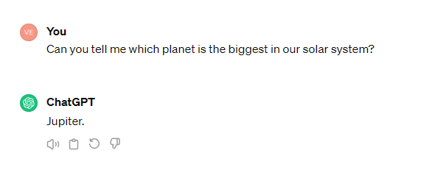
Do It on Your Own: Self-Consistency Prompting
Use ChatGPT to try out the prompt below:
Notes:
Instructor Notes:
Duration: 5 mins
Instruct learners to use the provided prompt from the slide to produce output. Share both the prompt and the response they receive in the Zoom chat.
Explain: This technique is called Self-consistency prompting. We will learn more about it.

Slide 22

Tree-of-Thought Prompting (ToT)
It is a method in GenAI models that helps solve complex problems.
It forms a tree with various thought paths or steps, resembling branches on a tree.
Each branch represents a potential step or idea toward solving a problem.
The AI evaluates these branches to identify the best solution.
It is useful for tasks that require strategic thinking or involve multiple steps.
Notes:
Tree of Thought (ToT) prompting is a method used in AI language models to solve complex problems. It involves creating a 'tree' of different thought paths or steps, much like branches on a tree. Each branch represents a possible step or idea towards solving a problem. The AI evaluates these branches to find the best solution. This method is particularly useful for tasks that need strategic thinking or multiple steps.

Slide 23
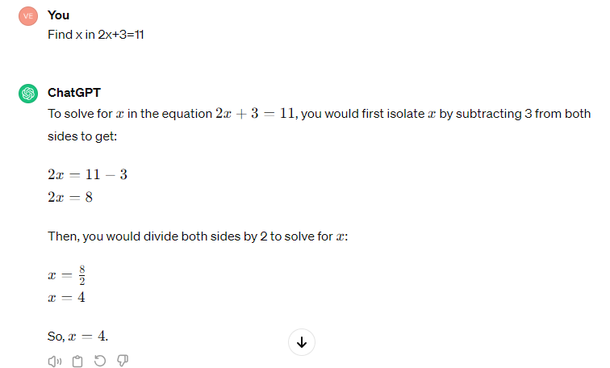
ToT Prompting: Example
Use ChatGPT to try out the prompt below:
Note: The AI uses ToT to break down the problem into smaller steps, evaluate each step, and arrive at the correct solution.
Notes:
Instructor Note:
Demonstrate using ChatGPT: Find x in 2x+3=11
Explain:
First, the LLM considers deducting 3 from both sides, considering it a good step.
Next, it considers, "What should I multiply with 2 to get 8?" It evaluates this and recognizes it is on the right track.
Finally, it concludes, "x equals 4," ensuring that each step logically leads to this answer.
Do It Yourself:
Duration: 2 mins
Share the below problem with learner and instruct them to perform it using ChatGPT
Find the missing number in the following series:
2, 6, 12, 20, ?, 42, 56

Slide 24
Best Practices for Creating Prompts
Notes:
Let's go over the best practices for creating effective prompts.

Slide 25

Best Practices: Prompt Creation​
Dos
Begin the requests with clear and specific framing.
Example: List 5 Paris tourist attractions with 2-3 sentence descriptions.
Offer context by providing background details​.
Example: I'm writing an article on sustainable farming practices, so I need information on the benefits of crop rotation and how it improves soil health.
Notes:
Here are some best practices to follow when creating prompts."

Slide 26
Best Practices: Prompt Creation​
Dos
Ask follow-up questions if the response lacks completeness​.
Example: Your explanation of photosynthesis was helpful, but could you also briefly explain how plants use the energy produced during that process?
Provide guidelines early on regarding tone, length, and format​.
Example: For this blog post, I need around 500 words written in a conversational, lighthearted tone with examples or analogies to explain complex concepts. Please use headings to break it into 3-4 sections.
Notes:
Here are some best practices to follow when creating prompts."

Slide 27
Best Practices: Prompt Creation​
Don’ts
Don’t provide unnecessary details​.
Example: Just give me the ingredients list for a basic spaghetti recipe, nothing more. I don't need details on preparation steps, cooking times, or serving suggestions.
Don’t give it too many tasks to perform at the same time​.
Example: First, draft an outline for the introduction section of the report. Then, research and write the background information. After that, analyze the data and summarize the key findings. Let's work on one component at a time.
Notes:
Let's review the common pitfalls to avoid when creating prompts

Slide 28
Best Practices: Prompt Creation​
Don’ts
Don't provide any contradictory statements while prompting.
Example: ​Describe a utopian society where everyone lives in harmony, but also include details about conflicts and divisions between different groups.
Note: Always validate the information given by the tool, as the GenAI model might generate an inaccurate response.
Notes:
Let's review the common pitfalls to avoid when creating prompts

Slide 29
Refining Prompts
15
In this demo, we will continue iterating on the prompt, demonstrating techniques like:
Asking clarifying questions about elements that are still vague or unclear
Providing examples to illustrate the desired type of response
Adding or removing specificity as needed
Setting guidelines for length, tone, structure, and more
Note: Please download the demo documents from the LMS Reference Material Section for a detailed explanation.
Notes:
Instruct the learners to download the demo documents from the Reference Materials section.

Slide 30
Introduction to Fine-Tuning
Notes:
Let's start by understanding the basics of fine-tuning AI models

Slide 31


Pre-Training
Pre-training is the process of training a GenAI model on a large corpus dataset.
Prompt
LLM
Pre-trained model
Large dataset
Generated output
Notes:
This slide is self-explanatory

Slide 32


Fine-Tuning
Fine-tuning involves taking pre-trained models and training them more on smaller, specific datasets to enhance performance in a particular task or domain.
Why is network traffic encrypted?
Why is network traffic encrypted?
Network traffic is encrypted using complex algorithms to prevent unauthorized interception. This safeguards sensitive data from potential attackers, ensuring confidentiality and integrity. Common encryption protocols include SSL/TLS, IPsec, and WPA2 for web, VPN, and wireless traffic, respectively.
Because it protects data during transmission
Pre-trained model
Fine-tuned model
Notes:
Instructor Notes:
In this example, the base model provides a simplistic answer about protecting data during transmission. However, the fine-tuned model, which has been trained on computer networking concepts, gives a more detailed and technically accurate explanation. It covers the principles of secure communication, the role of encryption in protecting data confidentiality and integrity, common encryption protocols used in various networking scenarios, and the importance of encryption for information security in computer networks.

Slide 33

Benefits of Fine-Tuning
Fine-tuning ChatGPT offers several benefits, including:
Enhanced performance
Adaptation to domain-specific data
Reduced training time and cost
Notes:
Fine-tuning ChatGPT offers several advantages, including enhanced performance, reduced training time, and domain adaptation, making it a powerful tool for a wide range of natural language processing tasks.

Slide 34
Improved Performance and Domain Adaptation
Fine-tuning GPTs on task-specific data helps them understand the subtle details and complexities of the target domain.
Encrypted files with the .zzz extension, ransom note demanding payment?
Encrypted files with the .zzz extension, ransom note demanding payment?
LLM
LLM
Pre-trained model
Fine-tuned model
Cybersecurity data
Potential malware infection
Likely a ransomware attack using the .zzz ransomware variant. Immediate actions: isolate infected systems, disable network shares, identify patient zero, and initiate an incident response plan.
Notes:
Instructor Notes:
The base model still provides a general diagnosis of a potential malware infection based on the observed symptoms.
However, the fine-tuned model, leveraging cybersecurity data, accurately identifies the specific ransomware variant responsible (.zzz) and provides detailed, actionable recommendations tailored to the ransomware incident:
Isolate infected systems to prevent further spread.
Disable network shares to contain the infection.
Identify the initial system infected (patient zero) to understand the attack vector.
Initiate a comprehensive incident response plan to address the ransomware attack systematically.
This example highlights how fine-tuning with domain-specific data enhances the model's ability to precisely diagnose and characterize the technical issue, while also providing domain-relevant guidance for an effective response.

Slide 35
Considerations for Fine-Tuning Language Models
Fine-tuning isn't always the best choice. Consider this scenario: You've fine-tuned a base model using your Slack messages dataset.
Write a report analyzing the impacts of climate change.
Sure, I can work on that report tomorrow and have it ready for you.
No, I need you to write it now. I'm on a tight deadline.
Understood. Let me begin drafting that report analyzing climate change impacts right away.
Notes:
This example shows how fine-tuning a model on narrow datasets like Slack messages can lead to informal responses and procrastination, which are not suitable for tasks requiring immediate and formal responses.
Balancing fine-tuning with diverse data sources ensures the model retains its ability to perform a wide range of tasks effectively, avoiding over-specialization that can cause loss of general capabilities.

Slide 36
Challenges of Fine-Tuning
Overfitting
Undesirable fine-tuning behavior where an LLM excels on training data but struggles with new tasks or domain-specific data.
Catastrophic forgetting
Fine-tuning may cause the LLM to forget all pre-training knowledge, leading to catastrophic forgetting.
Expensive
Fine-tuning LLMs for specific tasks demands substantial data, which is difficult to collect and expensive. Complex computing infrastructure adds to the cost.
Bias
Pre-trained LLMs may carry biases, which can worsen during fine-tuning. Bias mitigation measures should be in place before fine-tuning.
Note: The process of fine-tuning is time-consuming and expensive to implement.
Notes:
Instructor Notes:
If any learner inquires about a demonstration of fine-tuning in a real-world application, kindly inform them that fine-tuning is a highly resource-intensive process, both in terms of time and expense. Therefore, conducting a live demonstration is not feasible.

Slide 37
30
In this activity, you will craft an effective prompt by applying advanced prompting techniques. This activity will help you gain hands-on experience with writing prompts.
Note: Please download the demo documents from the LMS Reference Material Section for a detailed explanation.

Slide 38
Prompt engineering involves creating clear and effective instructions to guide large language models in generating desired outputs.
Advanced techniques in prompt engineering, such as zero-shot and few-shot methods, assist in creating effective prompts.
Fine-tuning customizes large language models for specific tasks or fields using specialized data.
Notes:
Mode: Sync
Estimated duration: 5 mins
Type: Instructor-led activity

Slide 39
How to Become a Prompt Engineer: Your Path to AI Mastery
Notes:
Share this link with the learners and encourage them to make use of this article in their free time
https://www.simplilearn.com/how-to-become-a-prompt-engineer-article

Slide 40
Notes:
Mode: Sync
Estimated duration: 5 to 10 mins
Type: Whole-Group Activity

